Slide 1
2020 NFHS Baseball Rules Powerpoint
www.sfvumpires.org /sanfernandovalleyumpires
Notes:
Thank you for participating in this annual interpretation meeting. While the rules of baseball are in great shape, we continue to work toward improving the sport by recruiting and retaining more young people. We have to continue to strive to provide safe conditions and place them in situations that they are able to find success in some aspect of the sport. Ultimately, our goal is for them to be safe, have fun and gain some valuable life lessons from participation. New additions to our rules are indicated by underlining of the change. Deletions are noted by a strike-through of the deleted text.

Slide 2
2020 NFhs baseball rule changes
www.sfvumpires.org /sanfernandovalleyumpires

Slide 3
ANNOUNCEMENT
2020 Study Guide is now available for completion online
CBUA website: https://cbuaump.org
Study Guide window closes
Sunday February 9, 2020 11:59pm PST (23:59)
www.sfvumpires.org /sanfernandovalleyumpires

Slide 4
ANNOUNCEMENT
2020 Certification Exam window will open Monday February 10, 2020
It will close on Sunday March 1, 2020 11:59pm PST (23:59)
Passing grade of 85% MUST be achieved
Test may be taken multiple times
www.sfvumpires.org /sanfernandovalleyumpires

Slide 5
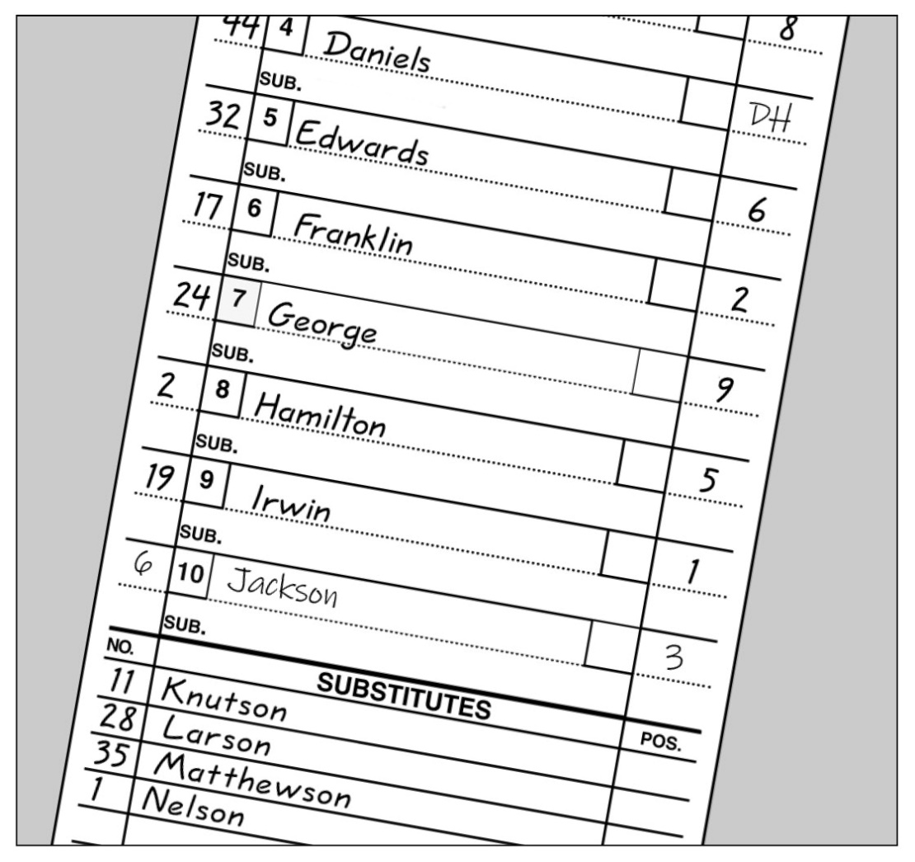
Designated hitter Rule 3-1-4
The DH rule now has three options:
(1) You can start the game with no DH. If so, you cannot add a DH later.
(2) You can use the DH option that we have had in FED for the last decade or more. DH may bat for anyone (F1-F9) in the line up
Notes:
The designated hitter has been a mainstay rule for decades. It has not changed. We have only added another option with the same concept.

Slide 6
Designated hitter Rule 3-1-4
(3) You can have a player start the game as a Defensive Player / DH. (For example, F4/DH). This must be marked on the line-up card. If the player is removed from the game on defense, he remains as the DH for the player who replaced him on defense. However, under this option of the DH rule, if the DH is substituted for on offense (either by a pinch-hitter or a pinch-runner) the role of the DH is terminated for the remainder of the game. So, if a team uses this third option, the only player who can ever play the position of "DH" for the entire game is the starter.
Notes:
The designated hitter has been a mainstay rule for decades. It has not changed. We have only added another option with the same concept.

Slide 7
Designated hitter Rule 3-1-4
An offensive substitution eliminates the DH status nut does not eliminate that player’s re-entry eligibility. He may re-enter as a defensive player but no longer retains DH status
.
Notes:
The designated hitter has been a mainstay rule for decades. It has not changed. We have only added another option with the same concept.

Slide 8
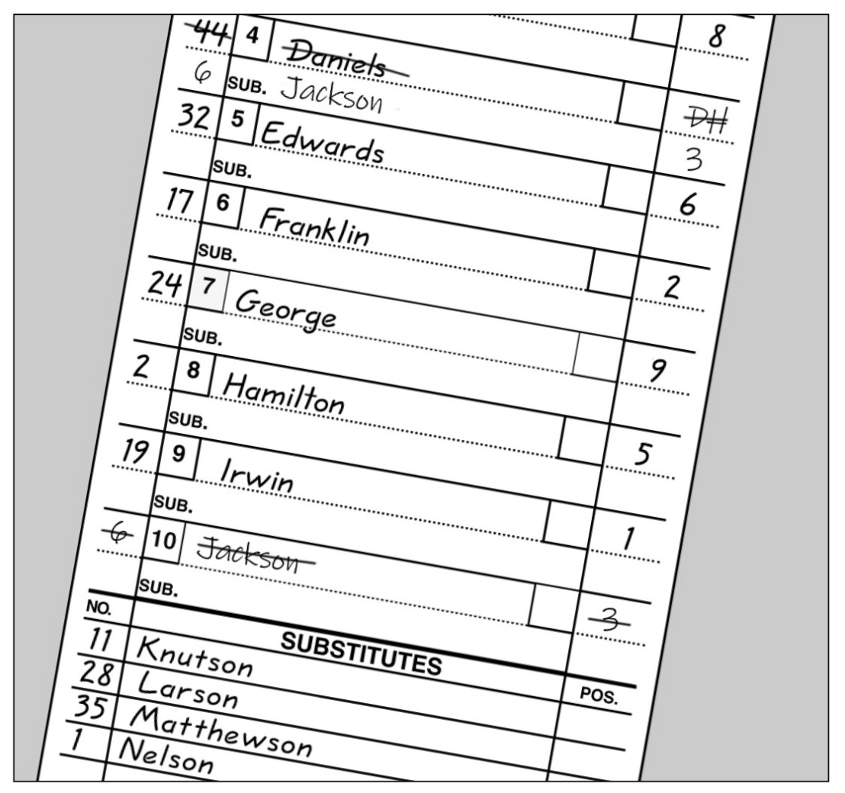
Designated hitter Rule 3-1-4a1
While there is no change from the previous DH rule.
When using a standard designated hitter, the role of the DH is still terminated for the remainder of the game when the defensive player for whom the DH batted, subsequently bats, pinch-hits or pinch-runs.

Slide 9
Designated hitter Rule 3-1-4b
The starting designated hitter (DH) may now be any one of the starting defensive players, including the pitcher.
A Player/DH then holds two positions: defensive player and designated hitter.

Slide 10
Designated hitter Rule 3-1-4b
In the case where one player is listed as a starting DH and a starting defensive player in the lineup, the role of the defensive player may be substituted for by any legal substitute.
The original player/DH may re-enter defensively one time.

Slide 11
Designated hitter Rule 3-1-4b-1
When using the P/DH, the role of the DH is terminated for the remainder of the game when any player substitutes offensively for the DH.

Slide 12
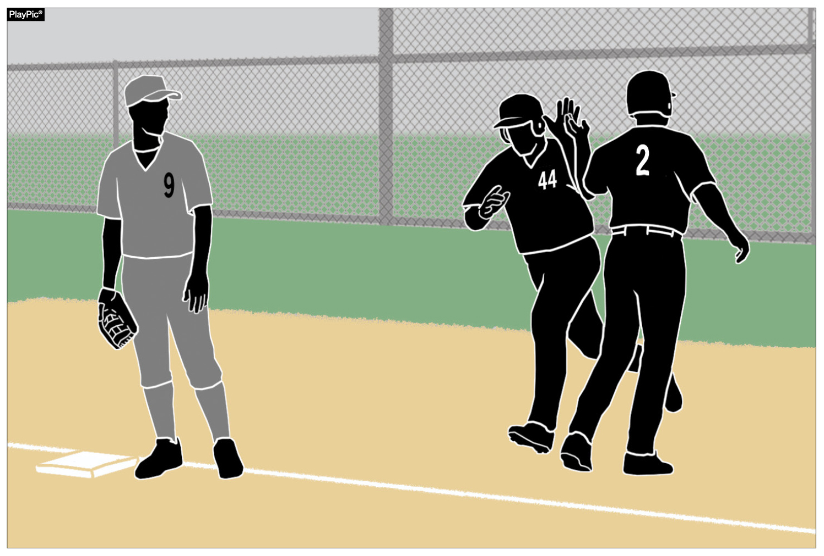
Designated hitter Rule 3-1-4b-2
As a reminder from the previous rule, the role of the DH is terminated for the remainder of the game when the starting defensive Player/DH is substituted for either as a hitter or a runner.

Slide 13
Designated Hitter (DH) Rule 3-1-4
ART. 4 . . . A hitter may be (not mandatory) designated for any one starting player (not just pitchers) and all subsequent substitutes for that player in the game. A starting defensive player cannot be listed as the designated hitter in the startup. A designated hitter for said player shall be selected prior to the start of the game, and his name shall be included on the lineup cards presented to the umpire-in-chief and to the official scorer.

Slide 14
Designated Hitter (DH) Rule 3-1-4
A team forfeits the use of a designated hitter if it fails to declare a designated hitter prior to the game. If a pinch hitter or pinch runner for the designated hitter is used, that player becomes the new designated hitter. The player who was the designated hitter may re-enter as the designated hitter under the re-entry rule. A designated hitter and the player for whom he is batting are locked into the batting order. No multiple substitutions may be made that will alter the batting rotation.
Notes:
If a pinch hitter or pinch runner for the DH is used, that player becomes the new DH under the first option (the standard DH).

Slide 15
Designated Hitter (DH) Rule 3-1-4
The role of the designated hitter is terminated for the remainder of the game when: A designated hitter may be used in one of the two scenarios:
a.The defensive player, or any previous defensive player for whom the designated hitter batted, subsequently bats, pinch-hits, or pinch-runs for the designated hitter; or
a. The designated hitter may be a tenth starter hitting for any one of the nine starting defensive players. If the designated hitter (DH) is used in this manner, the role of the DH is terminated for the remainder of the game when:

Slide 16
Designated Hitter (DH) Rule 3-1-4
1. The defensive player, or any previous defensive player for whom the designated hitter batted, subsequently bats, pinch-hits, or pinch-runs for the designated hitter; or
2. The designated hitter or any previous designated hitter assumes a defensive position.

Slide 17
Designated Hitter (DH) Rule 3-1-4
Rationale:
This rule change will provide coaches some options to strategize how to keep their better players in the game, to contribute to the offensive output of the team and give another player a chance to participate on defense. In addition, considering the pitch count rules, this change would help pitchers to keep their bat (because they are typically the best hitter) in the game, but can come out of the game to protect their arms from overuse.

Slide 18
Points of emphasis
www.sfvumpires.org /sanfernandovalleyumpires

Slide 19
Designated hitter
There are now two options when using a designated hitter: the standard DH and the player/DH. Teams may also still choose to start the game without using a designated hitter (straight 9). All options must be declared prior to the start of the game.

Slide 20
Designated hitter
The courtesy runner (CR) can never have any function with a designated hitter (DH). When a DH comes to bat, he is a DH (regardless of either lineup option); when at bat, he can never assume a defensive position. As a result, a CR is never a legal substitute for a DH.
Notes:
Neither CIF-SS nor CIF-LACS allow a courtesy runner. For pace of play purposes tournament games may be an exception in accora

Slide 21
Designated hitter
If the DH is batting for another player, when he bats, he is a DH. As a result, if a runner comes in for him when he gets on base, it is a substitution, and that player is now the DH. If the DH is a Player/DH, he is batting as the DH. A substitution by an offensive player would eliminate the role of the DH.

Slide 22
Game-ending procedures
A state association may adopt game-ending procedures that determine how games are ended, including suspended games. However, if a state does not adopt game-ending procedures, by mutual agreement of the opposing coaches and the umpire-in-chief, any remaining play may be shortened or the game terminated. If a state association has adopted game-ending procedures, only those game-ending procedures may be used, unless the opposing coaches wish to terminate the game (4-2-4).
Notes:
CIF-LACS has mandatory “10 run rule (VAR & JV), CIF-SS individual league by adoption (verify at plate meeting)

Slide 23
Force-play slide rule
Runners are never required to slide, but if a runner elects to slide at any base, it must be legal. A legal slide can either be feet first or head first. If a runner slides feet first, at least one leg and buttock shall be on the ground.

Slide 24
Force-play slide rule
Runners may not pop-up into the fielder.

Slide 25
Force-play slide rule
Runners may not have a leg raised higher than the fielder’s knee.

Slide 26
Force-play slide rule
Except at home plate, runners may not slide through or beyond the base.

Slide 27
Force-play slide rule
Runners may not slide away from a base in the direction of the fielder. But a runner may slide in a direction away from a fielder to avoid making contact or altering the play of the fielder.

Slide 28
Force-play slide rule
The runner is out when he illegally slides. On a force play, the runner is also guilty of interference. The batter-runner is also declared out and all other runners must return to the base occupied at the time of the pitch.
Notes:
No one may advance on interference

Slide 29
COMPLIANT BASEBALL
The ball shall meet the current NOCSAE standard for baseball effective January 1, 2020. The NFHS authentication mark and the NOCSAE mark shall both be visible on the ball.
Notes:
If the home team does not have the properly marked baseballs DO NOT PLAY THE GAME but give them an opportunity to acquire properly marked baseballs. We will designate 30 minutes to be a proper opportunity. If at the end of 30 minutes properly marked baseball have not been procured, inform the participating schools that the game WILL NOT be played. DO NOT declare the game to be a forfeiture nor a no-contest. Contact the Assignor and Instructional Chair immediately upon returning to your vehicle.

Slide 30
Baseballs Rule 1-3-1
Effective January 1, 2020 the SEI/NOCSAE mark is required on all baseballs that meet the NOCSAE standard that will be used in high school competition.
Baseballs shall have the SEI/NOCSAE mark along with the NFHS Authenticating Mark.
Rationale:
To maintain a consistent and uniform standard for high school competition. To ensure that every baseball manufactured meets the same level of quality and playability.

Slide 31
COMPLIANT BODY AND CHEST PROTECTOR
The catcher’s body/chest protector shall meet the NOCSAE standard effective Jan. 1, 2020.
Notes:
The compliant NOCSAE Body protector will have to be worn underneath the traditional chest protector.

Slide 32
Chest and body protector Rule 1-5-3
The catcher shall wear, in addition to a head protector, a mask with a throat protector, body/chest protector that meets the NOCSAE standard at the time of manufacture (Effective January 1, 2020), protective cup (male only), and baseball protective shin guards. The SEI/NOCSAE mark is required on all body/chest protectors that meets the NOCSAE standard at the time of manufacture that will be used in high school competition.

Slide 33
Chest and body protector Rule 1-5-3
Rationale:
A SEI/NOCSAE standard has been developed to protect the heart and the cardiac silhouette from commotio cordis. The NOCSAE standard could be included in a product that is either a separate device/apparel or a device constructed into a traditional chest protector. This proposal is recommended and endorsed by the NFHS Sports Medicine Advisory Committee (SMAC) to minimize risk. The catcher has to wear either a chest protector that meets the NOCSAE standard or a body protector that meets the NOCSAE standard underneath a traditional chest protector. It is the responsibility of the coach to verify that his/her players are properly equipped and in uniform.

Slide 34
COMPLIANCE OF PLAYER EQUIPMENT
A face mask/guard specifically designed for a particular helmet model may be attached after manufacture, provided that procedure is approved by the manufacturer and meets the SEI/NOCSAE standard at the time of manufacture.
Notes:
Cheek and jaw protectors are allowed to be used on batting helmets.

Slide 35
PROPER PITCHING POSITIONS
The windup is one of two legal pitching positions. For the windup, the pitcher’s non-pivot foot shall be in any position on or behind a line extending through the front edge of the pitcher’s plate.

Slide 36
PROPER PITCHING POSITIONS
The set is one of two legal pitching positions. For the set position, a pitcher shall stand with his entire non-pivot foot in front of a line extending through the front edge of the pitcher’s plate and with his pivot foot in contact with or directly in front of and parallel to the pitcher’s plate.

Slide 37
PROPER PITCHING POSITIONS
Pitchers are no longer required to have their entire pivot foot in contact with the pitcher’s plate. This recognizes that many mounds are such that it is problematic for the pitcher to have his entire pivot foot in contact with the pitcher’s plate.
Notes:
By decree of the CBUA Executive Instructional Chair, at least 1/3 of the foot must be in contact with the pitcher’s plate. Easier to determine if F1 is in contact or not. Contact with/without will determine the potential base award.

Slide 38
PROPER PITCHING POSITIONS
The so-called hybrid stance is illegal as it does not meet the requirements of either the windup or set positions.
Notes:
“Square-up”

Slide 39
ENFORCEMENT OF nfhs JEWELRY RULE
Jewelry, including necklaces, bracelets and earrings, shall not be worn except for religious or medical medals. A religious medal must be taped and worn under the uniform. A medical alert must be taped and may be visible.

Slide 40
Thank you and have a great Baseball season!
San Fernando Valley Contacts:
DWAYNE FINLEY, CIF-SS Area Liaison, sfvliaison@gmail.com, (818) 430-7772
KIRK WEST, Assignor, lites4you@aol.com, (818) 371-6487
DAX VILLALTA, Instructional Chairman, dvillalta@email.com, (323) 646-3411
www.sfvumpires.org /sanfernandovalleyumpires

